Slide 1
The Number Mismatch Task
• In this task you will see four numbers in the middle of the screen
• Three numbers will be the same and one will be different
• You need to select the number that is different

Slide 2
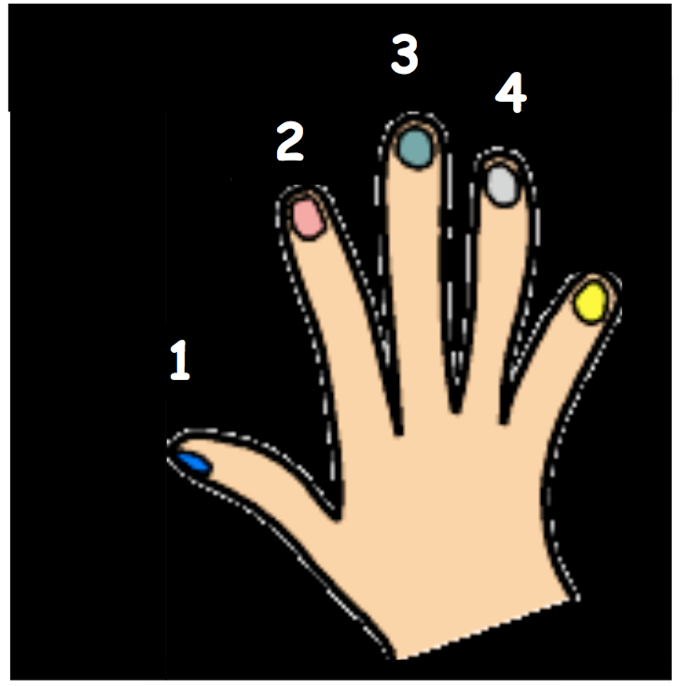

Slide 3
The Number Mismatch Task
Lets practice…
1 3 3 3
Which number is different?
Which finger button would you press?
1
2
3
4
Thumb
Index
Middle
Ring

Slide 4
The Number Mismatch Task
1 3 3 3
Number one is different
So you would press the index finger button
1
2
3
4
Thumb
Index
Middle
Ring

Slide 5
The Number Mismatch Task
Lets try one more …
2 3 2 2
Which number is different?
Which finger button would you press?
1
2
3
4
Thumb
Index
Middle
Ring

Slide 6
The Number Mismatch Task
2 3 2 2
Number three is different
So you would press the ring finger button
1
2
3
4
Thumb
Index
Middle
Ring

Slide 7
The Number Mismatch Task
*** Remember: focus on the number that is different, not its location ***

